Slide 1

DETECTING FAKE NEWS Using Machine Learning
Batch-4:
Gumpena Veera Durga Jyothi[19P31A0588]
Pogiri SaiLakshmi[19P31A05A5]
Barsha Gupta[19P31A0572]
Shravan Shaji[19P31A05B0]

Slide 2
CONTENTS
Abstract
Analysis
Block Diagram
Features Extraction
Modules identified in proposed system
System Design
Requirements
Conclusion

Slide 3

Abstract
In our modern era where the internet is ubiquitous, everyone relies on various online resources for news. Along with the increase in the use of social media platforms like Facebook, Twitter, etc. news spread rapidly among millions of users within a very short span of time.
Eg: Corona Virus
The spread of fake news has far-reaching consequences like the creation of biased opinions to swaying election outcomes for the benefit of certain candidates.
Moreover, spammers use appealing news headlines to generate revenue using advertisements via clickbaits.
To detect Whether the news is fake or real ,we will use web scraping using Parsehub Tool and Logistic Regression Model.

Slide 4
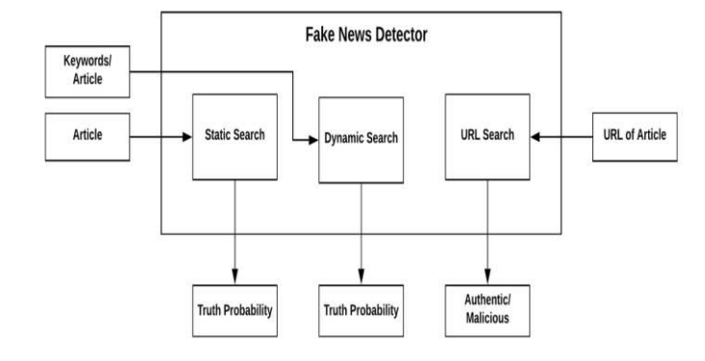
Analysis Block Diagram

Slide 5

Web Scraping

Slide 6
ParseHub Tool
ParseHub Tool
ParseHub is an incredibly powerful and elegant tool that allows you to build web scrapers without having to write a single line of code. It is therefore as simple as simply selecting the data you need. ParseHub is targeted at pretty much anyone that wishes to play around with data. This could be anyone from analysts and data scientists to journalists.
Features of ParseHub
Clean Text and HTML before downloading data.
Simple to use graphical interface.
ParseHub allows you to collect and store data on servers automatically.
Automatic IP rotation.
Scraping behind logic walls allowed.
Provides Desktop Clients for Windows, Mac OS, Linux.
Data is exported in JSON or Excel Format.
Can extract data from tables and maps.

Slide 7
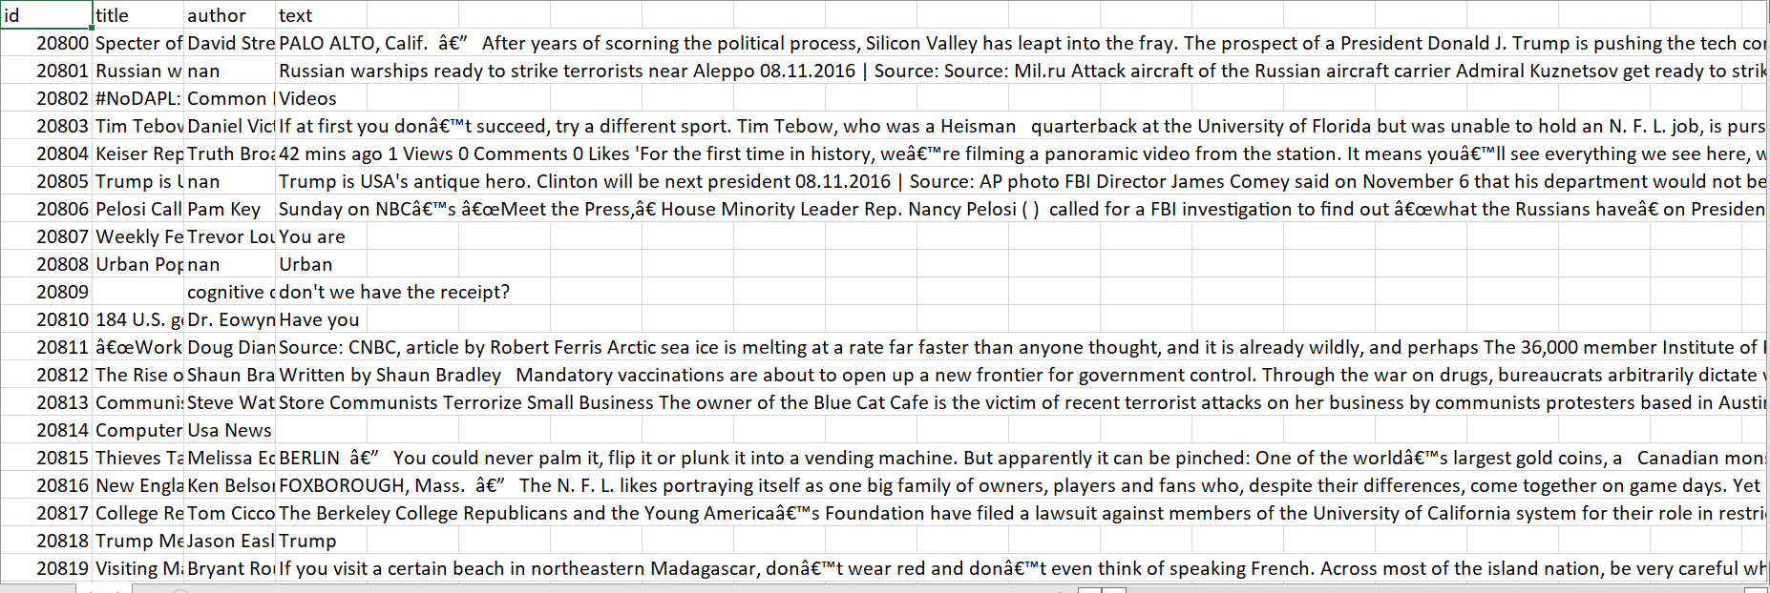
Dataset consider to build the model Sample Train Dataset

Slide 8
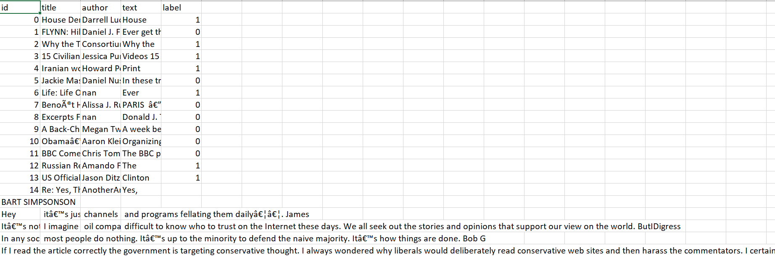
Sample Test Dataset

Slide 9
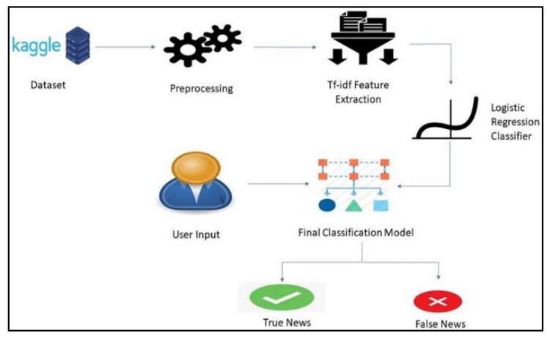
System architecture

Slide 10
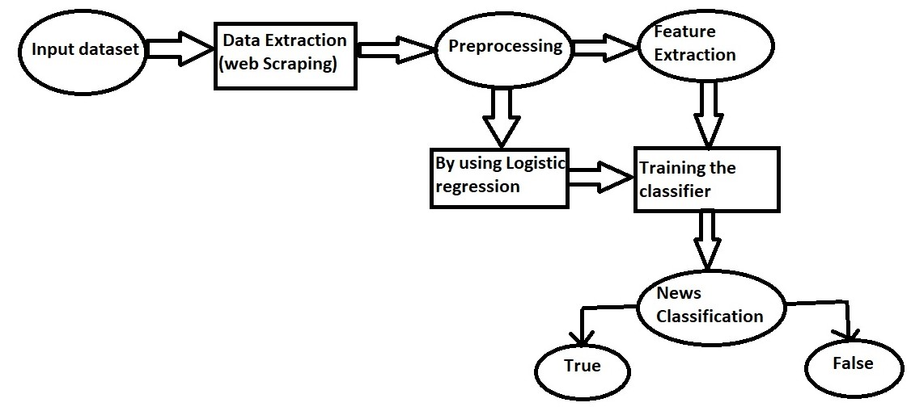
Data Flow Diagram

Slide 11
FEATURES EXTRACTION
Feature Extractions Like news aggregrator which collect news different websites.
news authentication that a given news is present or not in our database using sequence matcher form difflib module.
news recommendation which gives news recommendation based on our search matching keywords, predictions which use to train our data give result with the given input is fake or real.
TF-IDF Vectorization.

Slide 12
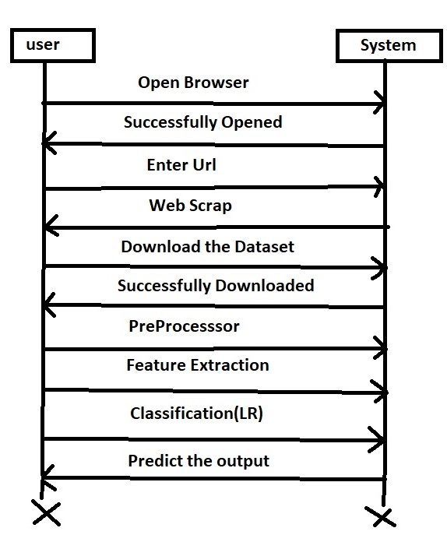
Uml Diagrams Sequence Diagram

Slide 13
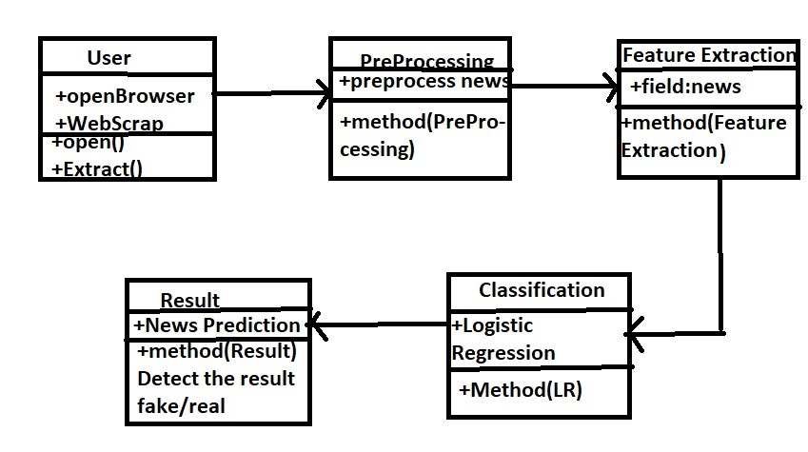
Class Diagram

Slide 14
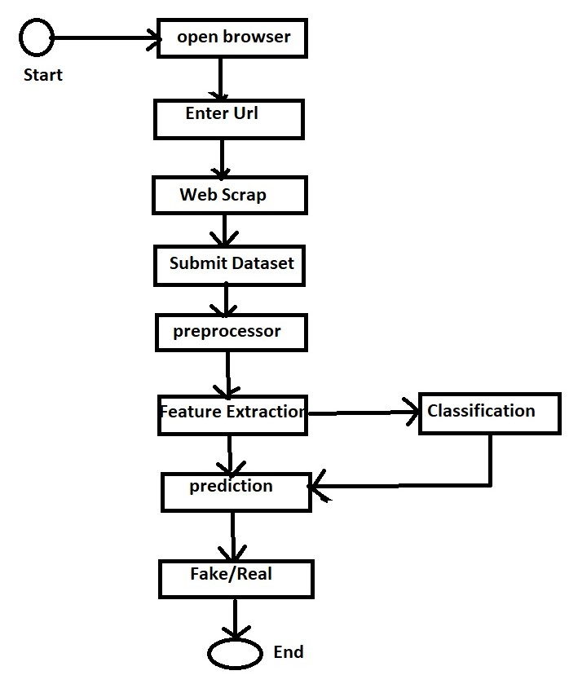
Activity Diagram

Slide 15
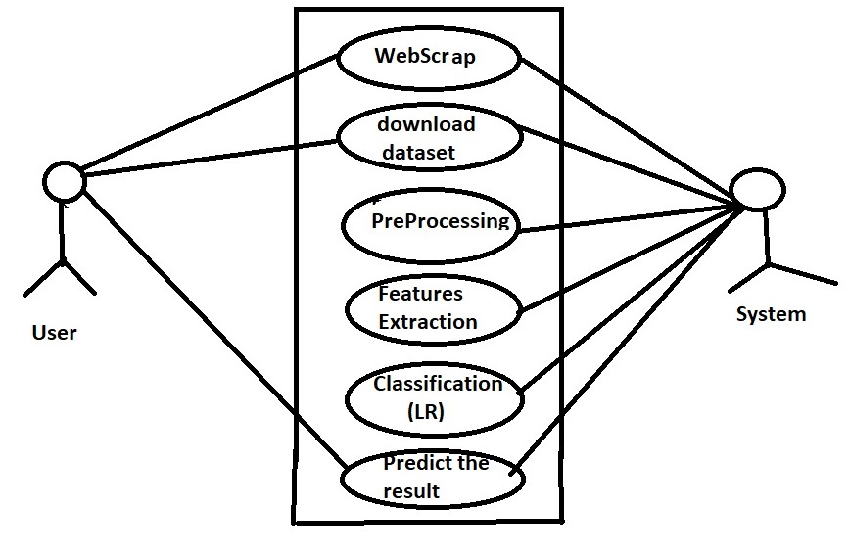
UseCase Diagram

Slide 16
Algorithm
Step0: open colab/jupyter to write the code.
Step1: Importing libraries/dependencies.
Step2: By using web Scraping(ParseHub) collect the dataset.
Step3:Load the dataset.
Step4:Data preprocessing should be done.
Step5:stemming should be done.
Step6:Transform our textual data to numerical so that our Ml model can understand it and work with it.
Step7:perform TF-IdF Vectorization.
Step8;splitting the dataset.
Step9:Training and Testing should be done
Step10:Find the accuracies of Train and Test dataset.
Step11:Building a system.
Example code:
Taking a sample out of the test set we will perform
X_sample = X_test[0]
Prediction for test sample we will use following code
prediction = model.predict(X_sample) if prediction == 0: print('The NEWS is Real!') else: print('The NEWS is Fake!')

Slide 17
REQUIREMENTS
Hardware Requirements:
Processor: Intel i3
Ram:8GB
Hard disk:100 GB
Software Requirements:
Colab.
Web Scraping (ParseHub Tool).
Python programming Language.

Slide 18
Conclusion
As social media is continuously growing, more people easily get news through social media as compared to traditional forms of news mediums. Networking though online modes now used to spread distorted news, which may lead to significant or adverse effects on consumers side and wider to the community. Through this work, a technique is proposed where in there is a combination of two different approaches for achieving improved accuracy in recognition of fake news.
This approach uses effective data cleaning and categorization which helps in improved accuracy. The web scraping module is combined with classification module further improves the accuracy of the approach. Both of these modules work in parallel therefore, the overall training time is reduced.

Slide 19


